Slide 1
Day One ML
Introduction to Machine Learning, Using AutoGluon

Slide 2
While you’re waiting for class to begin…
Answer this question in a text document and keep it handy:
What business problem(s) do you want to solve with Machine Learning (ML) in your own work/team?
Try to be as specific as possible
(2-3 sentences max)!

Slide 3
Agenda & Course Overview
Day One ML – Module 1

Slide 4
Agenda & Course Overview
Module
Module 1: Fundamentals of Machine Learning
Module 2: ML Lifecycle & Building Models with AutoGluon
Module 3: Code Demo & Course Project Work
Module 4: Solution Walkthrough & Advanced AutoGluon
Module 5: Identifying Machine Learning Opportunities
Notes:
…
- Learn about ML fundamentals (~2h),
- build, evaluate, and improve ML models with AutoGluon (AG) (~4h),
- along with, identifying business problems that could be/should be solved with ML tools (~1h)
(vs. business problems that do not require ML, can be solved with traditional methods, etc.)
Administrative announcements:
There will be 10 minutes breaks before the top of every hour or so
The whole session is recorded, and the recording will be shared shortly after class for future reference
Feel free to ask questions, add comments, share knowledge at any time during the session (chime, slack)
[CLICK for Next Slide]

Slide 5
When you leave this class, you should be able to:
Participate in ML discussions with team members
Leverage AutoGluon notebooks in SageMaker to solve ML problems
Match ML tasks to their respective domain (classical ML, Computer Vision, Natural Language Processing)
Cast simple business problems as ML problems
Determine if a business problem can and should be solved with ML

Slide 6


How to complete this course:
You must make at least one model submission to our leaderboard: https://leaderboard.corp.amazon.com/tasks/718
Submission closes Sunday midnight UTC
After completion, student and manager receive a confirmation email.
Completion awards this phone tool icon:
Top 3 for each class get this phone tool icon:
Notes:
For the organized classroom version of the course, as I’ve just mentioned, you get a chance to apply and experiment what we discuss here on a real world dataset,
participate in a Kaggle-like ML competition hosted on our Leaderboard platform,
build a ML model on the provided training dataset,
and submit your modeling predictions to the platform to get scored on a test dataset.
[Descriptive Text]
The week’s top 3 submissions will be awarded the MLU Champion Icon.

Slide 7



Resources
Notebooks to build, train, and deploy machine learning models quickly
Slack
Channel
Slack Channel to discuss questions with classmates & instructors.
Your
classmates
Collaborate
Share ideas
Connect
Network
Learn
Notes:
The most important thing in ML is writing code and experimenting hands-on
Jupyter Notebook is the most popular tool for doing DS/ML in Python
This is what we will be using throughout this course,
on AWS SageMaker Notebook instances
We can only cover so much in this accelerated dive into ML, so
check out the open-source (text)book, Dive into Deep Learning at D2L.ai
Amazonians’ attempt to make ML, and in particular DL, approachable with Jupyter notebooks.
And, if you are going through this course with a group of ML enthusiasts, being in a classroom or online,
- collaborate, share ideas and experiments, learn from each others mistakes and successes,
to quickly build expertise with these new tools and techniques.
Also, please go ahead post your technical question to Sage, using MLU or D2L tags, to leverage the knowledge of the larger Amazon ML community.

Slide 8
Module 1:
Fundamentals of Machine Learning

Slide 9
Filling the Shelves
Day One ML – Module 1

Slide 10
Books in the Amazon Product Catalog
To sell books on Amazon.com we require certain information about the book itself (price, title, author, description, etc.).

Slide 11
Books in the Amazon Product Catalog
To sell books on Amazon.com we require certain information about the book itself (price, title, author, description, etc.).
Currently, Amazon.com product catalog contains approx. 6M unique book titles.

Slide 12
Books in the Amazon Product Catalog
To sell books on Amazon.com we require certain information about the book itself (price, title, author, description, etc.).
Currently, Amazon.com product catalog contains approx. 6M unique book titles.
The most important piece of information we need to have for any book is the price.
Notes:
Hazmat problem???

Slide 13
Crucial Gaps in the Catalog
What if due to data loss or buyer error…
the price information is missing?!

Slide 14
Crucial Gaps in the Catalog
What if due to data loss or buyer error…
the price information is missing?!
Even if just 0.1% of books in Amazon’s catalog were missing a price, that equals ~60,000 books that can’t be sold.

Slide 15
Crucial Gaps in the Catalog
What if due to data loss or buyer error…
the price information is missing?!
Even if just 0.1% of books in Amazon’s catalog were missing a price, that equals ~60,000 books that can’t be sold.
We cannot manually add prices as the product catalog constantly updates and grows → require an automated solution.
Notes:
(missing description or dimension is not great, but not a blocker).

Slide 16
Let’s try out some ideas
Let’s try simple ‘if – then’ rule (short books should be cheaper, as there is less material cost).
If book > 200 pages: 30 USD, else: 10 USD.

Slide 17
Let’s try out some ideas
Let’s try simple ‘if – then’ rule (short books should be cheaper, as there is less material cost).
If book > 200 pages: 30 USD, else: 10 USD.
What could go wrong?

Slide 18
Let’s try out some ideas
Let’s try simple ‘if – then’ rule (short books should be cheaper, as there is less material cost).
If book > 200 pages: 30 USD, else: 10 USD.
A 1000 page book for just $30?! …cheating with font size?
What could go wrong?

Slide 19
Let’s try out some ideas
Let’s try simple ‘if – then’ rule (short books should be cheaper, as there is less material cost).
If book > 200 pages: 30 USD, else: 10 USD.
A 1000 page book for just $30?! …cheating with font size?
Need a smarter & scalable way to fill gaps → Machine Learning!
What could go wrong?

Slide 20
What is ML?
Day One ML – Module 1

Slide 21
Traditional: Rules-based
Data
Rules get applied to Data (classical programming)
Answers
Rules
Notes:
So, what is Machine Learning?
Arthur Samuel, an American computer scientist, IBMer and pioneer of the field of Artificial Intelligence, coined the term in 1959 by stating that
“Programming computers to learn from experience should eventually eliminate the need for much of this detailed programming effort”
“A computer can be programmed so that it will learn to play a better game of checkers than can be played by the person who wrote the program.”
In other words, ML is teaching a machine to learn how to do a task,
through algorithms that can learn from experience
without relying on rules-based programming.
That sounds very similar to classical programming, still need to code something...
the key difference is that in classical programming, you need to provide an exact recipe (code, sequence of steps/if/else/etc)
that tells the machine what rules to apply to solve the problem and provide the answers.
Now, manually crafting and enhancing rules can be a difficult and cumbersome task,
sometimes impossible as we don’t know the rules to begin with,
And often requires that golden/rare piece of domain expertise/top expert perspective you saw in the Data Science diagram
Think of writing a program for the complex task of face recognition
WITH ML: we move this heavy lifting onto the machine
Still need to provide some code (ML algorithm, a set of instructions) and DATA (ideally with answers)
but that code will instruct the machine how to learn/extract the RULES from the DATA&ANSWERS
These Machine-Inferred / Machine-Learned RULES, which are what’s called,
the trained ML model
can then be further used to provide answers to new similar problems, on new similar data.

Slide 22
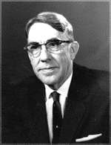
What is Machine Learning?
Data
Rules get applied to Data (classical programming)
Answers
Rules
“Programming computers to learn from experience should eventually eliminate the need for […] detailed programming effort.”
Arthur Samuel, 1959 Pioneer of AI research
Data
ML Model (learns rules from data using algo)
Answers
ML Algorithm
New Data
Notes:
So, what is Machine Learning?
Arthur Samuel, an American computer scientist, IBMer and pioneer of the field of Artificial Intelligence, coined the term in 1959 by stating that
“Programming computers to learn from experience should eventually eliminate the need for much of this detailed programming effort”
“A computer can be programmed so that it will learn to play a better game of checkers than can be played by the person who wrote the program.”
In other words, ML is teaching a machine to learn how to do a task,
through algorithms that can learn from experience
without relying on rules-based programming.
That sounds very similar to classical programming, still need to code something...
the key difference is that in classical programming, you need to provide an exact recipe (code, sequence of steps/if/else/etc)
that tells the machine what rules to apply to solve the problem and provide the answers.
Now, manually crafting and enhancing rules can be a difficult and cumbersome task,
sometimes impossible as we don’t know the rules to begin with,
And often requires that golden/rare piece of domain expertise/top expert perspective you saw in the Data Science diagram
Think of writing a program for the complex task of face recognition
WITH ML: we move this heavy lifting onto the machine
Still need to provide some code (ML algorithm, a set of instructions) and DATA (ideally with answers)
but that code will instruct the machine how to learn/extract the RULES from the DATA&ANSWERS
These Machine-Inferred / Machine-Learned RULES, which are what’s called,
the trained ML model
can then be further used to provide answers to new similar problems, on new similar data.

Slide 23
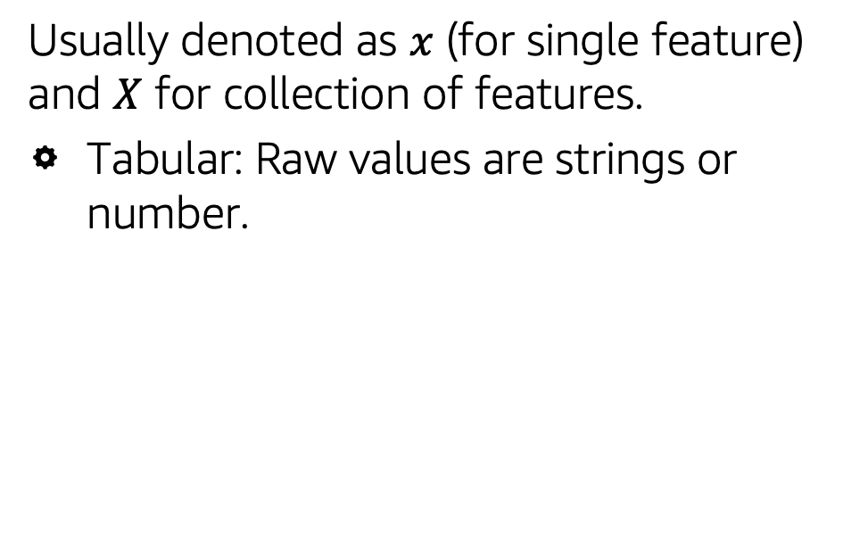

Data: Features & Labels
Features (Data/Input)
Usually denoted as $x$ (for single feature) and $X$ for collection of features.
Tabular: Raw values are strings or number.
Month Sold | Year Sold | Condition | Sale Price
7 | 2008 | Normal | 18.10
7 | 2007 | Normal | 13.00
7 | 2008 | Normal | 19.99
10 | 2006 | Abnormal | 25.20
9 | 2006 | Normal | 30.90
6 | 2010 | Normal | 16.60
Table 1: Tabular dataset

Slide 24
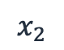
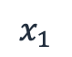
Data: Features & Labels
Features (Data/Input)
Usually denoted as $x$ (for single feature) and $X$ for collection of features.
Tabular: Raw values are strings or number.
$$x_{1}$$
$$x_{2}$$
…
Month Sold | Year Sold | Condition | Sale Price
7 | 2008 | Normal | 18.10
7 | 2007 | Normal | 13.00
7 | 2008 | Normal | 19.99
10 | 2006 | Abnormal | 25.20
9 | 2006 | Normal | 30.90
6 | 2010 | Normal | 16.60
Table 1: Tabular dataset

Slide 25
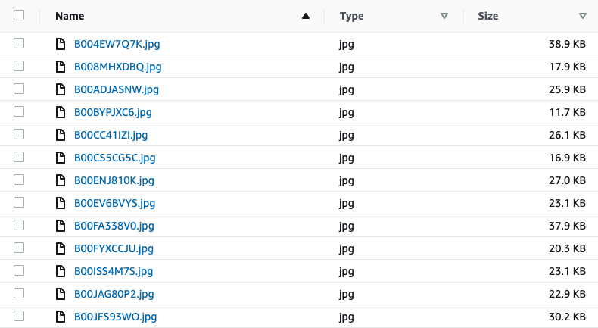
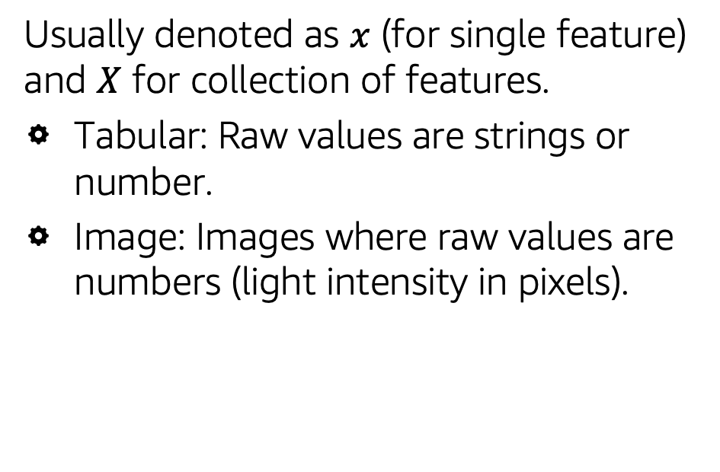
Data: Features & Labels
Features (Data/Input)
Usually denoted as $x$ (for single feature) and $X$ for collection of features.
Tabular: Raw values are strings or number.
Image: Images where raw values are numbers (light intensity in pixels).
Table 2: Image dataset

Slide 26
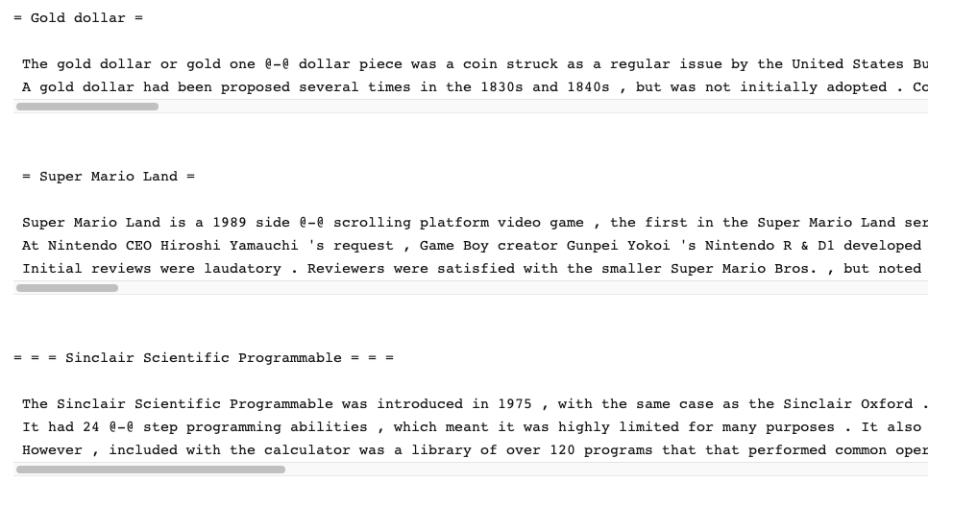
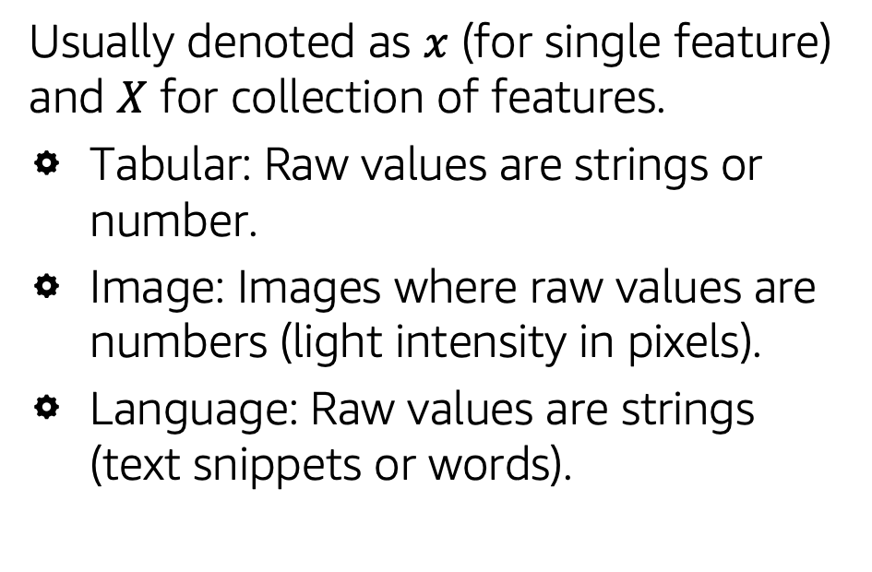
Data: Features & Labels
Features (Data/Input)
Usually denoted as $x$ (for single feature) and $X$ for collection of features.
Tabular: Raw values are strings or number.
Image: Images where raw values are numbers (light intensity in pixels).
Language: Raw values are strings (text snippets or words).
Table 3: Language dataset
https://www.salesforce.com/products/einstein/ai-research/the-wikitext-dependency-language-modeling-dataset/

Slide 27

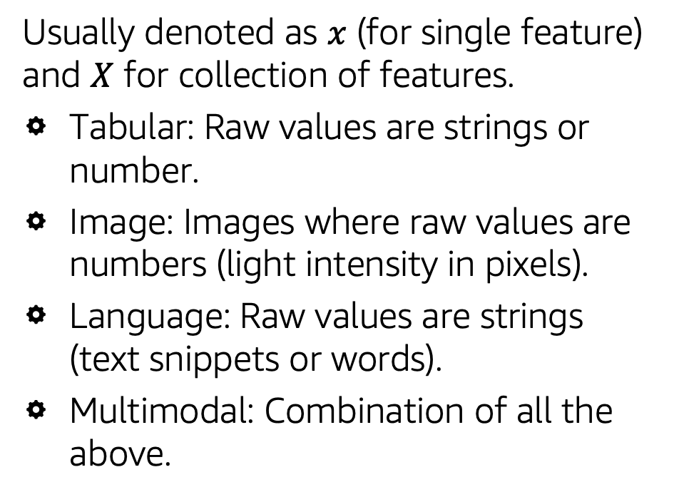
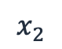
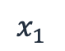
Data: Features & Labels
Features (Data/Input)
$$X$$
Usually denoted as $x$ (for single feature) and $X$ for collection of features.
Tabular: Raw values are strings or number.
Image: Images where raw values are numbers (light intensity in pixels).
Language: Raw values are strings (text snippets or words).
Multimodal: Combination of all the above.
$$x_{1}$$
$$x_{2}$$
…
Price | Type | Description | imgID
99.99 | Grocery | Sugar Free … | 51QjPP6oAVL
36.99 | Health | Sports Recovery … | 31WGVoL8mlL
19.99 | Grocery | Simple Jam… | 41c3RVsWGfL
39.99 | Beauty | Therapy Oil … | 51OMvEHU2QL
Table 4: Multimodal dataset

Slide 28
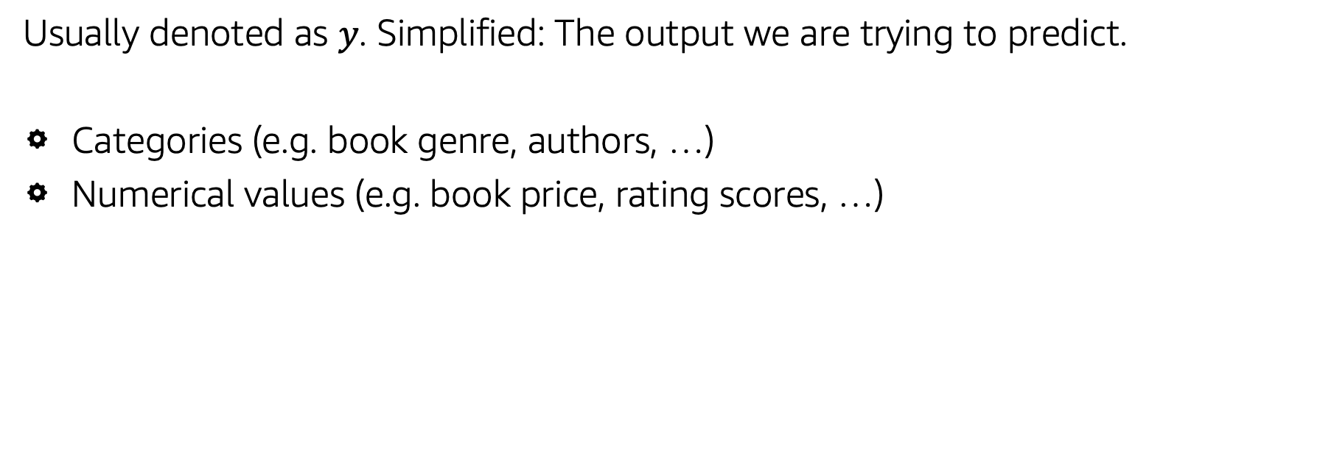
Data: Features & Labels
Labels (Target/Output)
Usually denoted as $y$. Simplified: The output we are trying to predict.
Categories (e.g. book genre, authors, …)
Numerical values (e.g. book price, rating scores, …)

Slide 29
ML Algorithm: Example
prediction ~ weighted combination of features
Notes:
Here is an example algorithm. This has been simplified from what you might use in a real environment, but it shows the two key components of an algorithm: features and weights.

Slide 30
ML Algorithm: Example
prediction ~ weighted combination of features
$$\hat{y} =f\left(x\right)≈a_{0}x_{0}+a_{1}x_{1}+…+{a_{4}x_{4}+…+a}_{n}x_{n}$$
Notes:
Here is an example ML algorithm. This has been simplified from what you might use in a real environment,
but it shows the two key components of an algorithm: features and weights.
[READ Descriptive Text]
[CLICK for Next Slide]

Slide 31
ML Algorithm: Features
prediction ~ weighted combination of features
$$\hat{y} =f\left(x\right)≈a_{0}x_{0}+a_{1}x_{1}+…+{a_{4}x_{4}+…+a}_{n}x_{n}$$
Feature: Measurable piece of information
Notes:
e.g., the 4th book feature in our ‘filling the shelves’ example could be ‘no of pages’…
READ Descriptive Text]
[CLICK for Next Slide]

Slide 32
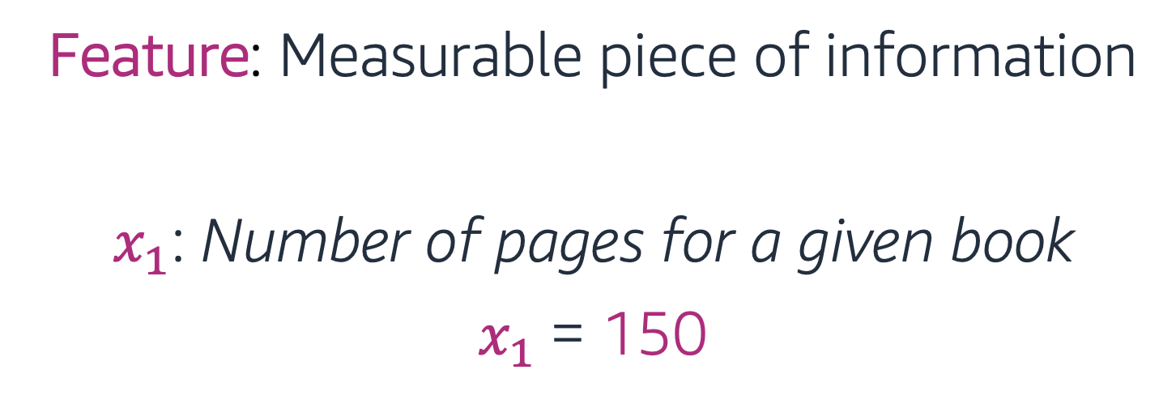
ML Algorithm: Features
prediction ~ weighted combination of features
$$\hat{y} =f\left(x\right)≈a_{0}x_{0}+a_{1}150+…+{a_{4}x_{4}+…+a}_{n}x_{n}$$
Feature: Measurable piece of information
$x_{1}$: Number of pages for a given book
$x_{1}$= 150
Notes:
e.g., the 4th book feature in our ‘filling the shelves’ example could be ‘no of pages’…
READ Descriptive Text]
[CLICK for Next Slide]

Slide 33
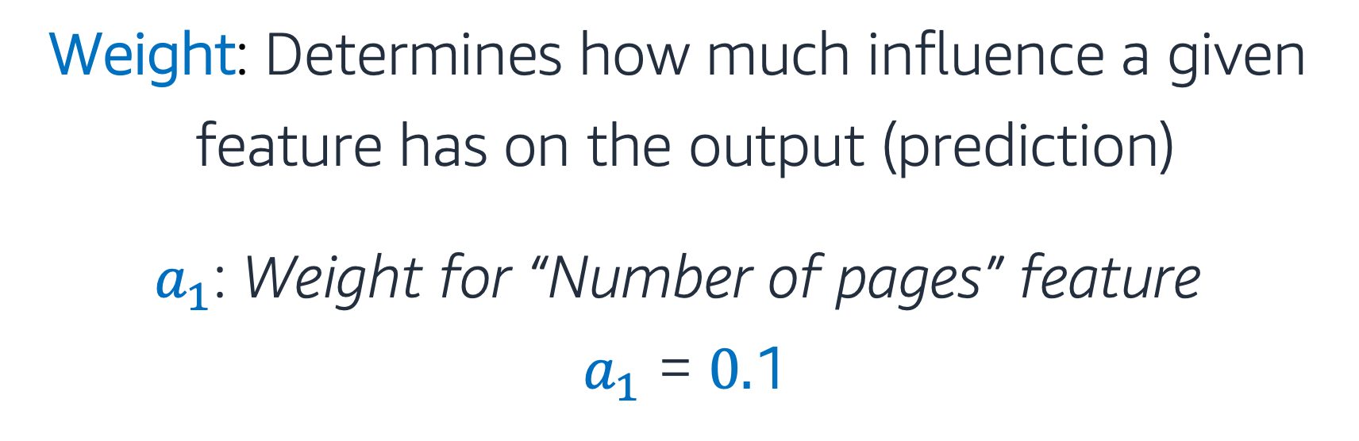
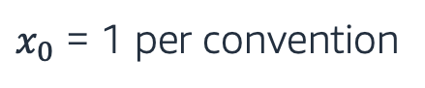
ML Algorithm: Weights
prediction ~ weighted combination of features
$$\hat{y} =f\left(x\right)≈a_{0}x_{0}+a_{1}150+…+{a_{4}x_{4}+…+a}_{n}x_{n}$$
Weight: Determines how much influence a given
feature has on the output (prediction)
$a_{1}$: Weight for “Number of pages” feature
$a_{1}$ = $0.$1
$x_{0}$ = 1 per convention
Notes:
[READ Descriptive Text]
Note the a0*x0 term, a term that does not depend on the features, with a0 aka. bias term
[CLICK for Next Slide]

Slide 34
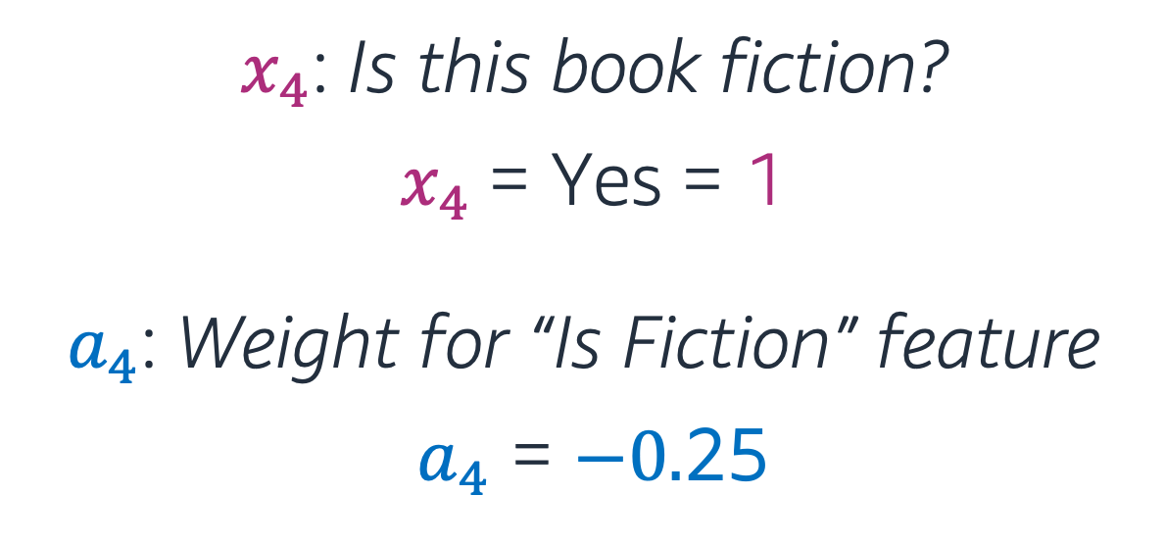
ML Algorithm: Features & Weights
prediction ~ weighted combination of features
$$\hat{y} =f\left(x\right)≈a_{0}1+0.1∗150+…+a_{4}x_{4}{+…+a}_{n}x_{n}$$
$x_{4}$: Is this book fiction?
$x_{4}$= Yes = 1
$a_{4}$: Weight for “Is Fiction” feature
$a_{4}$ = $−0.$25
Notes:
e.g., the 4th book feature in our ‘filling the shelves’ example could be ‘is the book fiction’…
[READ Descriptive Text]
[CLICK for Next Slide]

Slide 35
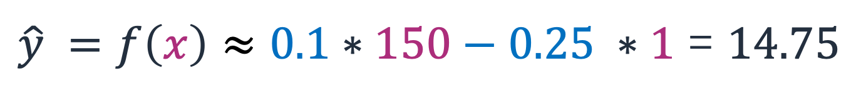
Output
prediction ~ weighted combination of features
$\hat{y} =f\left(x\right)≈0.1∗150−0.25 ∗1$ = $14.75$
(predicted price of a book with 150 pages and fiction genre)
Remember: This is a very simplified version of an ML algorithm. Real ML algorithms are more complex, but involve the same elements.
Notes:
So, for example, a model predicting book prices, based only on the selected features (no of pages, fiction/non-fiction),
setting the bias weight to 0 and assuming the other weights as a1 = 0.1 and an = -0.25,
would predict the price of a fiction book with 150 pages, as …
[READ Descriptive Text]
Now, if the predicted book price makes no sense compared with known prices for similar books,
the weights are further adjusted by the ML alg to ensure the prediction closely matches the labels
[READ Descriptive Text]
By more complex ML algorithms we generally mean (much) larger number of features and weights, in the order of millions/billions.
[Try classical programming to code that!]
[CLICK for Next Slide]

Slide 36
Hypotheticals: More Book Problems
Problem “Missing Genre”:
Too many books are being listed without genre data, making it difficult for buyers to find them. You need to provide suggestions on what genre a book might belong to.
Problem “Fraudulent Listings”:
Sometimes bad actors make fraudulent listings for used books. You need to be able to identify likely fraudulent listings so they can be flagged for review.

Slide 37
Types of Machine Learning
Day One ML – Module 1

Slide 38
Supervised vs. Unsupervised Learning
Data is provided with labels
Model learns by looking at these examples
Supervised Learning
Unsupervised Learning
Data is provided without labels
Model finds patterns in data
Notes:
Aside from labeled or unlabeled data,
another interesting thing about Machine Learning is the
variety of Machine Learning algorithms, sometimes to solve the same type of problem.
While certain algorithms tend to perform better than others with certain types of data,
no single algorithm outperforms all others on all problems.
This concept is called the no free lunch theorem.
And so, for a given task/problem,
choose a few algorithms known to work well for that type of data and problem,
and select the best-performing one.
Let’s narrow down initial choices by dividing ML algorithms into categories,
based on the task they perform and how they perform it.

Slide 39
Supervised vs. Unsupervised Learning
Supervised Learning
Unsupervised Learning
Regression (Quantity)
Classification (Category)
Clustering
e.g. book price prediction
e.g. book genre prediction
e.g. fraud prediction
Notes:
Aside from labeled or unlabeled data,
another interesting thing about Machine Learning is the
variety of Machine Learning algorithms, sometimes to solve the same type of problem.
While certain algorithms tend to perform better than others with certain types of data,
no single algorithm outperforms all others on all problems.
This concept is called the no free lunch theorem.
And so, for a given task/problem,
choose a few algorithms known to work well for that type of data and problem,
and select the best-performing one.
Let’s narrow down initial choices by dividing ML algorithms into categories,
based on the task they perform and how they perform it.

Slide 40
Supervised vs. Unsupervised Learning
Supervised Learning
Unsupervised Learning
Regression (Quantity)
Classification (Category)
Clustering
ML Algorithms
Linear Regression
K-Nearest Neighbors
Neural Nets
Decision Trees
…
Support Vector Machine
K-Nearest Neighbors
Neural Nets
Decision Trees
…
PCA
Collaborative Filtering
K-Means
…
Notes:
Aside from labeled or unlabeled data,
another interesting thing about Machine Learning is the
variety of Machine Learning algorithms, sometimes to solve the same type of problem.
While certain algorithms tend to perform better than others with certain types of data,
no single algorithm outperforms all others on all problems.
This concept is called the no free lunch theorem.
And so, for a given task/problem,
choose a few algorithms known to work well for that type of data and problem,
and select the best-performing one.
Let’s narrow down initial choices by dividing ML algorithms into categories,
based on the task they perform and how they perform it.

Slide 41
Supervised Machine Learning
Day One ML – Module 1

Slide 42
Supervised Learning: Regression
Supervised Learning
Price [$]
Regression (Quantity)
Classification (Category)
# Pages
Label
Features
Linear Regression
K-Nearest Neighbors
Neural Nets
Decision Trees
…
Support Vector Machine
K-Nearest Neighbors
Neural Nets
Decision Trees
…
Price [$] | # Pages | Days pub. | Language | # Reviews
28 | 320 | 100 | EN | 2000
21 | 210 | 500 | DE | 400
… | … | … | … | …
Notes:
Let's talk about regression first - a very popular Supervised Learning problem type
Regression aims to learn relationships and correlations between input features and a continuous output variable,
with the scope of predicting the continuous output variable.
For example, the price of a house might depend on a certain combination of no of bedrooms, sqfootage, age and so on.
Shown here, for simplicity, a simple linear regression model,
assuming the relationship between the sale price of a house and the sqFootage is linear,
that is a straight line.
- as sqf increases, the price of the house increases.
Given historical data, that is sale prices of houses with these characteristics on the market,
one can learn such linear model that can be later used to predict the sale price of a new given home based on its descriptors / the sqfootage here.
Some ML algorithms that can be used to build regression models, are listed below:
Linear regression, KNN, Decision Trees, NN

Slide 43
Supervised Learning: Classification
Supervised Learning
Predict 0
Predict 1
/1 = Fiction
/0 = Non-Fiction
Days published
Regression (Quantity)
Classification (Category)
# Pages
Label
Features
Linear Regression
K-Nearest Neighbors
Neural Nets
Decision Trees
…
Support Vector Machine
K-Nearest Neighbors
Neural Nets
Decision Trees
…
Fiction | # Pages | Days pub. | Language | # Reviews
1 | 320 | 100 | EN | 2000
0 | 210 | 500 | DE | 400
… | … | … | … | …
Notes:
If you’d rather be interested to know whether the house given its characteristics will sell fast or not, that would be what’s called classification.
The other very popular Supervised Learning problem type, classification,
aims to learn relationships between input features and a output variable,
with the scope of separating the data into classes/groups.
The main difference between REGR and CLASS is that the output variable in regression is numerical (or continuous) while that for classification is categorical (or discrete).
For example, the star or not star classes shown here correspond to a certain combination of no of points, edges and size here…
This is what we call, a binary classification scenario, that is we only have two classes.
Some ML algorithms that can be used to build classification models, are …
Logistic Regression, SVM, KNN, Decision Trees, NN

Slide 44
Unsupervised Machine Learning

Slide 45
Unsupervised Learning: Clustering
Unsupervised Learning
# Reviews
Days pub.
Clustering
Features
K-Means
PCA
Collaborative Filtering
…
# Pages | Days pub. | Language | # Reviews
320 | 100 | EN | 2000
210 | 500 | DE | 400
… | … | … | …
Notes:
One example of Unsupervised Learning is clustering,
That involves grouping unlabeled data points according to their features.
For example, clustering can be used in market segmentation;
where we try to find customers that are similar to each other
whether in terms of behaviors or attributes.
Feature 1 could be age, and feature 2 could be the type of music the customers are listening to
Given that a visual overview of the data sometimes doesn’t suggest an obvious choice for the number of clusters, (or when it’s hard to visualize data to begin with – for example if we would like to use more than 4 features say)
If we don’t see or have prior information of how many clusters might be there
or a request from the business to produce a specified number of clusters,
the next challenge is to determine how many clusters to extract. This is a bit of a judgment call.
There are some metrics we can use to guide decision-making here,
but it’s most important that the clusters make sense and meet our objective
i.e., identifying as distinct as possible customers clusters for the business.

Slide 46
Unsupervised Learning: Clustering
Unsupervised Learning
# Reviews
Days pub.
Clustering
Features
K-Means
PCA
Collaborative Filtering
…
# Pages | Days pub. | Language | # Reviews
320 | 100 | EN | 2000
210 | 500 | DE | 400
… | … | … | …
Notes:
The most common kind of clustering is therefore called K-means clustering,
which involves first selecting K the number of desired clusters
and then partitioning the data into these K clusters
such that data points in each cluster are as similar as possible.
One possible outcome for our market segmentation problem is shown here for K = 3.
[During model training, the K-means algorithm uses the distances from datapoints to 3 possible centroids to assign the datapoints to the closest cluster centroid.]

Slide 47
Summary

Slide 48
ML Lingo Summary
Label = output you are trying to predict
Feature = data input to help you make predictions
Supervised learning
Trying to predict a specific label (quantity) using features
Need training data with labels
Can measure model performance directly
Unsupervised learning
Looking for structure or unusual patterns (“understand” the data)
No labeled data
Evaluation usually indirect (since not predicting something specific)

Slide 49
Module 2:
ML Lifecycle & Building Models with AutoGluon

Slide 50
Machine Learning Lifecycle
Day One ML – Module 1

Slide 51
Machine Learning Lifecycle
Answer
New Data/Re-training
Deployment
Business Problem
Yes
Data Processing
Data Collection
Data Exploration
Data Cleaning
…
Model
Training
Tuning
Testing
Evaluation
ML Problem Formulation
No
Notes:
With access to DATA, COMPUTE and ALGORITHMS,
How to do ML? what are the steps to follow?
Putting it all together here as ML Lifecycle, a preview of how much work is ahead…
As mentioned, all starts identifying a Business Problem and formulate the ML Problem
This is a step not to be taken lightly – will impact most of the downstream task
Ask pointed questions:
What are the business outcomes you are trying to achieve?
What does success look like for you?
What business metric to define?
Once settled on the ML Problem, the next step is also time consuming: Data
Know your problem/know your data! (again, and again, the domain expertise of the DS diagram!)
Get all relevant data in one place, cleaned and processed, in a so-called ML-friendly format
That will be all numericals, so you’ll have do to some data processing on those non-numerical features
Maybe also weed out some non-relevant features, or add some relevant ones in, etc
With your ML-friendly data and the right choice of ML algorithm, then
train-tune-validate an ML model
that can be deployed and used in production to produce the desired outcomes, if meets the business goals,
or can be tweaked further until meets the bar, otherwise.

Slide 52
Business problem
Problem formulation
Problem formulation
Data processing
Model
Evaluation
Deployment
Define the business objective:
Specific, measurable milestones that helps increase revenue, decrease cost, etc.
Translate objective to an ML problem:
Express the objective in machine learning terms, e.g., predicting, calculating the probability, etc.
Increase revenue by ensuring all products in catalog have prices & can be surfaced to customer.
Predict price (continuous numerical value) for all products in catalog where price is missing.

Slide 53
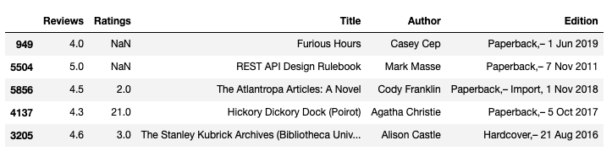
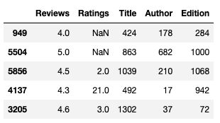
Business problem
Problem formulation
Data processing
Model
Evaluation
Deployment
Merging files from different sources together
Clean up data (dealing with missing values, …)
Convert all values to numbers (computers don’t understand text):
Tab 2 & 3: Example of conversion from original dataset to only numerical values with AutoGluon.

Slide 54
Business problem
Problem formulation
Data processing
Model
Evaluation
Deployment
Splitting Data for Model Training
Original dataset
Training set
(used to train the model)
Split
Validation set
(used for unbiased evaluation of the model)
Test set
(used for final evaluation of the model)
Notes:
In preparation for model fit, we split our data into these three subsets. We will evaluate errors on all of them and will learn different things from this. Let’s have a look at how to evaluate model performance first, then what we can learn from it.

Slide 55
Business problem
Problem formulation
Data processing
Model training
Evaluation
Deployment
Supervised models:
Train (learn) by comparing the error between prediction and true values (labels).
Unsupervised models:
Train (learn) by grouping similar things together. Similarity can be defined in different ways, e.g. distance, intersections of features.
Notes:
Aside from labeled or unlabeled data,
another interesting thing about Machine Learning is the
variety of Machine Learning algorithms, sometimes to solve the same type of problem.
While certain algorithms tend to perform better than others with certain types of data,
no single algorithm outperforms all others on all problems.
This concept is called the no free lunch theorem.
And so, for a given task/problem,
choose a few algorithms known to work well for that type of data and problem,
and select the best-performing one.
Let’s narrow down initial choices by dividing ML algorithms into categories,
based on the task they perform and how they perform it.
Animation for training: https://towardsdatascience.com/gradient-descent-animation-1-simple-linear-regression-e49315b24672

Slide 56
Business problem
Problem formulation
Data processing
Model training
Evaluation
Deployment
What are hyperparameters?
An adjustable parameter in an algorithm that influences the training process.
A machine learning model can have multiple hyperparameters.
Think of them like “options” or “settings” for your training jobs.

Slide 57
Business problem
Problem formulation
Data processing
Model training
Evaluation
Deployment
/1 = Fiction
/0 = Non-Fiction
P > 50
Days published (D)
90
yes
no
D > 90
D > 90
depth
# Pages (P)
50
yes
no
yes
no
Example Hyperparameters:
Depth: The depth of the tree.
Min Samples: Minimum number of datapoints required for splitting.

Slide 58
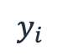
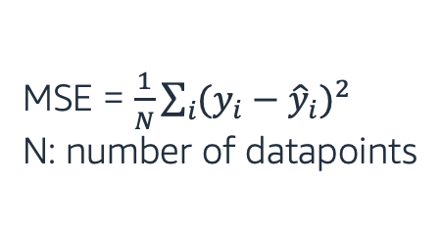
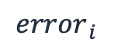
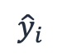
Business problem
Problem formulation
Data processing
Model
Evaluation
Deployment
Evaluation: Regression
Find distance (squared, absolute, …) between your prediction and labels.
Aggregate up into 1 value across whole dataset (e.g. mean error across squared distances, MSE).
Price [$]
$$y_{i}$$
True values
$${error}_{ i}$$
Predicted values
$${\hat{y}}_{i}$$
# Pages
MSE = $\frac{1}{N}\sum_{i}{{(y_{i}−{\hat{y}}_{i})}^{2}}$
N: number of datapoints
Notes:
Evaluating REGR models: Let’s first note that all these four regr metrics are looking at the overall model errors, either taking these errors in abs values or squared values (so that the negative errors can contribute in a meaningful way to the overall sum)
What do we mean by errors, are the differences between the y_is = target values (these are the y of our black dots data points here) and y_hats = the values predicted with the regression model (that will be the y’s of the points sitting on the orange regression line)
The first metric, the MSE (short for Mean Sq Error) is the average of the squared errors
As MSE squares the error differences, it penalizes even the smallest errors, leading to over-estimation of how bad the model is.
The next metric, the RMSE short for Root Mean Sq Error is also widely used for regression tasks, simply being the square root of the Mean Sq Error.
While Mean Sq Error reports errors in units squared, the Root Mean Sq Error reports the errors in the original units, making it easier to interpreted the error.
MAE short for…: is the average of the absolute differences between the target values and the values predicted by the model.
Being a linear score, all the individual differences are weighted equally, hence the MAE is more robust to outliers and does not penalize the errors as extremely as MSE.
R² on the other hand is a metric that helps compare our regr model with a constant average baseline model (that is predict averages for all data points), and tells us how much better the regr is vs this baseline model.
While with the other metrics, is desirable to lower the scores, the R2 is different.
Assuming that the ML model will always perform better than the baseline/average model, R² will take values between 0 and 1.
-If the regr model did not improve at all over the baseline model, producing same errors, R2 = 0 (lowest)
-The best regr model, meaning no errors between the predicted values and the actual values (MSE =0), R2 will be 1 (highest)
While the MSE is the most preferred metrics for regression tasks,
just like anything else with ML, there is no clear choice which metric to use.
Best practice is to monitoring a few, depending on the business problem and the dataset.
~~~~~~~~~~~~
LATEX
MSE = \frac{1}{n}\sum_{i=0}^{n}(y^{(i)}-\hat{y}^{(i)})^2
RMS = \sqrt{\frac{1}{n}\sum_{i=0}^{n}(y^{(i)}-\hat{y}^{(i)})^2}
MAE = \frac{1}{n}\sum_{i=0}^{n}|y^{(i)}-\hat{y}^{(i)}|
R^2 = 1 - \frac{\sum_{i=0}^{n}(y^{(i)}-\hat{y}^{(i)})^2}{\sum_{i=0}^{n}(y^{(i)}-\bar{y})^2}
\bar{y} = \frac{1}{n}\sum_{i=0}^{n}y^{(i)}
y^{(i)} \hat{y}^{(i)} \bar{y}

Slide 59
Business problem
Problem formulation
Data processing
Model
Evaluation
Deployment
Prediction
Evaluation: Classification
Compare true state to predicted state.
Aggregate up into 1 value across whole dataset by creating ratios (e.g. all correct predictions over total: accuracy).
1 (positive)
0 (negative)
True Positive
False Negative
1 (positive)
15
1
Predict 0
Predict 1
True State
False Positive
True Negative
/1 = Fiction
/0 = Non-Fiction
0 (negative)
Days published
3
18
# Pages
Notes:
How about evaluating classification models?
In the case of the classification models (a binary classification task shown here for simplicity)
the performance of the model and its associated errors can be judged by examining
correctly classified cases vs incorrectly classified cases.
Given our star/not star example, here called positive/negative classes,
we define as TP those data points that were pred P when the
…
We record our classifier results in a so called confusion matrix –
(reflecting the fact that the classifier is sometimes confused and makes mistakes)
For our binary classification problem the matrix has 2 rows and 2 columns.
Across the top are the predicted class labels and down the side are the actual class labels.
Each cell contains the number of predictions made by the classifier that fall into that cell.
The Conf Matrix makes it easier to observe the relations between the classifier outputs, and
Examining the CM usually gives a good idea whether or not the classifier we built is bad or good.
In our case here, we seem to have done at pretty good job at assigning most data points to their correct classes…
A perfect classifier would correctly predict all cases, so high numbers would stay on the main orange diagonal and nothing would fall off this diagonal into the False/error tiles
While the confusion matrix contains all information of the outcomes of a classifier,
is rarely used for reporting results because is difficult to compare and discuss.
Instead, some overall numerical scores extracted from the confusion matrix are commonly used.

Slide 60
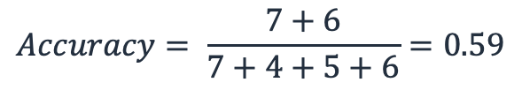
Business problem
Problem formulation
Data processing
Model tuning
Evaluation
Deployment
/1 = Fiction
/0 = Non-Fiction
Training
Validation
Predict 0
Predict 1
Predict 0
Predict 1
Days published
Days published
# Pages
# Pages
$$Accuracy= \frac{7+6}{7+4+5+6}=0.59$$
Notes:
So let’s stick with the classification case and evaluate on training and validation. We see a big difference in performance -> we learned characteristics of training data too well and ended up doing something that is called overfitting. Let’s have a look at the definition on the next slide.

Slide 61
Business problem
Problem formulation
Data processing
Model tuning
Evaluation
Deployment
Underfitting: Model is not good enough to describe the relationship between the features and the output.
Model is too simple to capture important patterns of training data.
Model will perform poorly on training and validation (and/or test).
Overfitting: Model memorizes or imitates training data, and fails to generalize well on new “unseen” data (test data).
Model is too complex, picks up the noise instead of the patterns of training data.
Model will perform well on training, but poorly on validation (and/or test).

Slide 62
Business problem
Problem formulation
Data processing
Model tuning
Evaluation
Deployment
Model Tuning & Testing
Learning
Original dataset
Training set
(used to train the model)
Train, tune, and validate the model (multiple times!)
Split
Validation set
(used for unbiased evaluation of the model)
Testing
Test set
(used for final evaluation of the model)
(Final) Test the model

Slide 63
Business problem
Problem formulation
Data processing
Model training
Evaluation
Deployment
Inference
Input
Model
Predictions
Cannot measure performance metric (beware of shifts)!
Deploy it to make predictions
Deployment
Once model performance is satisfactory, move to production
Yes
Evaluation
Notes:
Given new incoming x variables, and model f, predict y
Cannot measure accuracy since do not know true y in real-time
Predictions are then “consumed” by your business team/process and/or other downstream teams/processes
Input into business decisions, which may themselves be automated (or not)

Slide 64

Training $≠$ Reality
Covariate Shift: Distribution of training features is different than distribution in test features (temporal, spatial or less obvious reasons). Example “Web Search”:
Training – US vocabulary
Testing – UK vocabulary
Label Shift: Distribution of training labels is different than distribution in test labels (temporal, spatial or less obvious reasons). Example “Speech Recognition”:
Training - Pre-COVID world
Testing - Now
Notes:
Correction of label shift is harder to do because we don’t usually have the labels in test anymore. We can look compare confusion matrix of training set to confusion matrix of predictions. If the distributions are very different, we can work out what probability is for them to look so different.

Slide 65
ML Lifecycle – Trial, Error & Iterations
fit()
predict()
In theory:
In practice:
Start with a simple model and once it’s working, try out more advanced models during many iterations.
What if we combine multiple models to find the best answer? → Ensemble Learning
What if we automatically prep data and train try all eligible models? → AutoML (AutoGluon)
Data
ML Model
Rules
Answers
ML Algorithm
New Data
Notes:
Aside from labeled or unlabeled data,
another interesting thing about Machine Learning is the
variety of Machine Learning algorithms, sometimes to solve the same type of problem.
While certain algorithms tend to perform better than others with certain types of data,
no single algorithm outperforms all others on all problems.
This concept is called the no free lunch theorem.
And so, for a given task/problem,
choose a few algorithms known to work well for that type of data and problem,
and select the best-performing one.
Let’s narrow down initial choices by dividing ML algorithms into categories,
based on the task they perform and how they perform it.

Slide 66
Ensemble Learning
Day One ML – Module 2

Slide 67
Ensemble Learning
Ensemble methods create a model by combining the predictions of multiple models (base estimators, e.g. Decision Tree).
Each model is built with a given dataset and a given learning algorithm.
Ensemble Prediction
…
Model 1
Model 2
Model N
Data

Slide 68
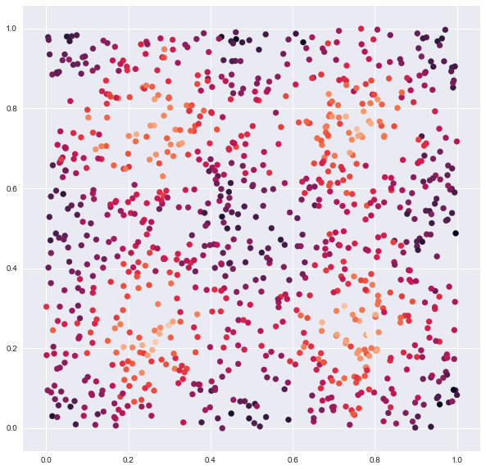

Ensembling: The Data
Price
Normalized Reviews
Normalized Ratings

Slide 69
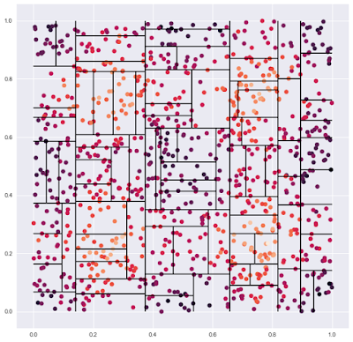
Ensembling: A Decision Tree
Price
Normalized Reviews
Normalized Ratings

Slide 70
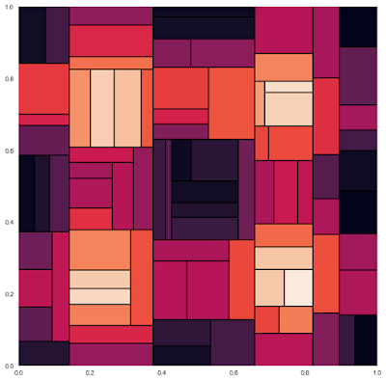
Ensembling: A Decision Tree
Price
Normalized Reviews
Normalized Ratings

Slide 71
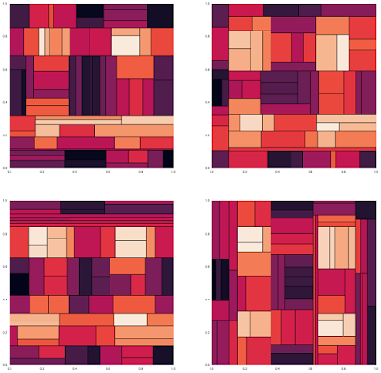
Ensembling: Many Decision Trees
Price
Each tree gives slightly different predictions.

Slide 72
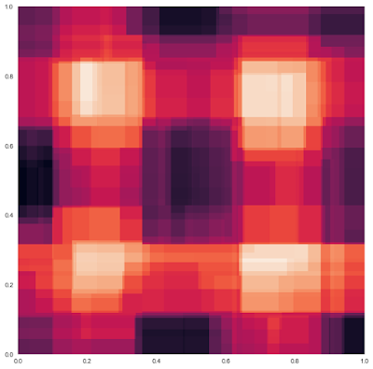
Ensembling: Random Forest
Price
Many are better than one: by combining through average we get better predictions.
Normalized Reviews
Normalized Ratings

Slide 73
Ensemble Learning Advantages
Advantages:
Many are better than few (ensemble prediction averages out the instability of individual models).
Models that learn differently can boost accuracy even if they are worse in isolation
Ensemble Prediction
…
Model 1
Model 2
Model N
Data

Slide 74
Ensemble Learning Disadvantages
Disadvantages:
Takes longer to train (each model learns separately)
More resources (computational power) required
More difficult to interpret
Ensemble Prediction
…
Model 1
Model 2
Model N
Data

Slide 75
AutoML & AutoGluon
Day One ML – Module 2

Slide 76

What is AutoML?
Codification of the best Machine Learning practices for data prep, algorithm selection, model training (and model tuning).
Goal is to automatically:
Pre-process data (according to data type)
Split data into train, validation (& test)
Find best performing models & combinations of models
(Find best model parameters)

Slide 77
AutoGluon Design Principles
Simplicity: Users can train a model on the raw data directly without knowing the details about the data and ML models.
Robustness: Works with a variety of datasets and ensures training succeeds even when some of the individual ML models fail.
Predictive Timing: Returns the results within the time-budget specified by users

Slide 78
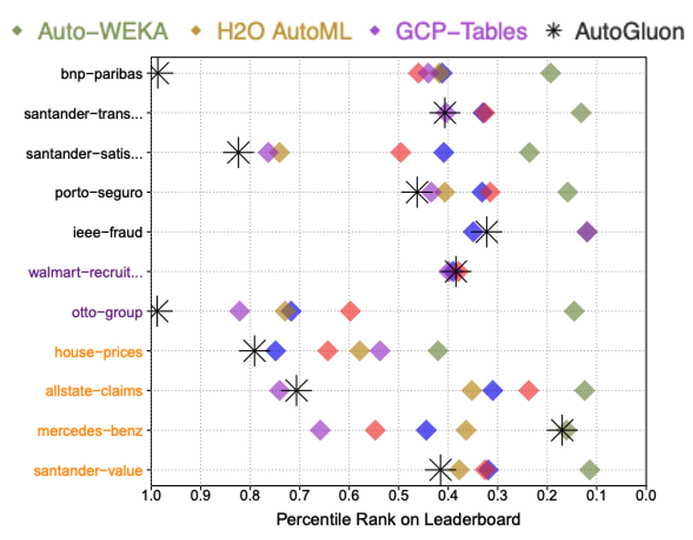
Can AutoGluon beat data scientists?
With just 24 hours of training time, AutoGluon managed to outperform 99.3% of data scientists participating in Kaggle competitions.
AutoGluon also achieves the highest raw accuracy among AutoML frameworks when directly predicting class labels.
https://arxiv.org/pdf/2003.06505.pdf

Slide 79
How can AutoGluon achieve these results?
AutoGluon:
Model ensembling via multi-layer stacking
Thoughtful data preprocessing & data prep
Greater emphasis on modern deep learning techniques
Less emphasis on hyperparameter optimization (optional)

Slide 80
K-fold Cross Validation (Example with K = 5)
Iteration-1
Iteration-2
Iteration-3
Iteration-4
Iteration-5
Training
Training
Training
Training
Validation
Training
Training
Training
Validation
Training
Training Set
Training
Validation
Training
Training
AutoGluon uses “repeated” k-fold cross validation if extra time remains. More trained models at the end.
Training
Training
Validation
Training
Training
Training
Validation
Training
Training
Training
Training
AutoGluon uses combined Out of the fold (validation) predictions for every data point in the training set as features for the next layer.
Notes:
We saw the training-validation sets earlier. Here, we introduce a new concept called “K-fold cross validation”. This gives you the opportunity to train and validate your choice of model multiple times, say K times, using the same dataset basically.
Here explained for K = 5
Repeat the following 5 times (Iterations 1-5):
Set aside 5th fold of the data for validation. This is also called “the hold-out set”.
Train the model on the remainder of the data: training set (4/5 of the original training set).
Test the model on the validation set (1/5 of the original training set).

Slide 81
Robust Model Selection & Training
AutoGluon anticipates and handles model training failures automatically.
AutoGluon also estimates future memory usage of individual models and skips expensive models & only loads one model into memory at a time.
→ AutoGluon fails on far fewer datasets compared to other AutoML solutions.

Slide 82
Efficient Time Management
Users can specify when system will be ready for prediction
Allocated fit() time is divided among models; individual models are early-stopped when their time is up
Reliably accurate & efficient models are trained before slower/less-reliable models)
Notes:
HPO: Hyperparameter Optimization CASH: Combined Algorithm Selection and Hyperparameter optimization

Slide 83
Coding with AutoGluon
Day One ML – Module 2

Slide 84
AutoGluon Installation
Install commands:
Brazil package:
https://code.amazon.com/packages/Python-autogluon/releases
python3 -m pip install -U pip
python3 -m pip install -U setuptools wheel
python3 -m pip install -U "mxnet<2.0.0"
python3 -m pip install autogluon

Slide 85
3 lines of code!
Only 3 lines of code to train and use a model using tabular data (for e.g. book price prediction):
from autogluon.tabular import TabularPredictor
predictor = TabularPredictor(label="Price").fit("train.csv")
predictions = predictor.predict("test.csv")
Notes:
Label doesn’t just have to be classification.

Slide 86
3 lines of code!
Only 3 lines of code to train and use a model using tabular data in general:
from autogluon.tabular import TabularPredictor
predictor = TabularPredictor(label="label").fit("train.csv")
predictions = predictor.predict("test.csv")

Slide 87
3 lines of code!
Only 3 lines of code to train and use a model:
Specify the column that contains the label in the training dataset.
from autogluon.tabular import TabularPredictor
predictor = TabularPredictor(label="label").fit("train.csv")
predictions = predictor.predict("test.csv")
Fit on the training dataset (learn the rules).
Produce predictions of the "label" column for rows in separate test dataset “test.csv”

Slide 88
.fit() Method
fit()automatically does the following:
Preprocesses raw data (identifies the type of each feature and converts to numerical values)
Identifies what type of prediction problem this is (binary/multi-class classification or regression)
Splits data appropriately (e.g. disjoint training/validation sets, k-fold split)
Individually trains various base models, creates an optimized ensemble that outperforms all of the individual models

Slide 89
AutoGluon Sub-Modules
Day One ML – Module 2

Slide 90
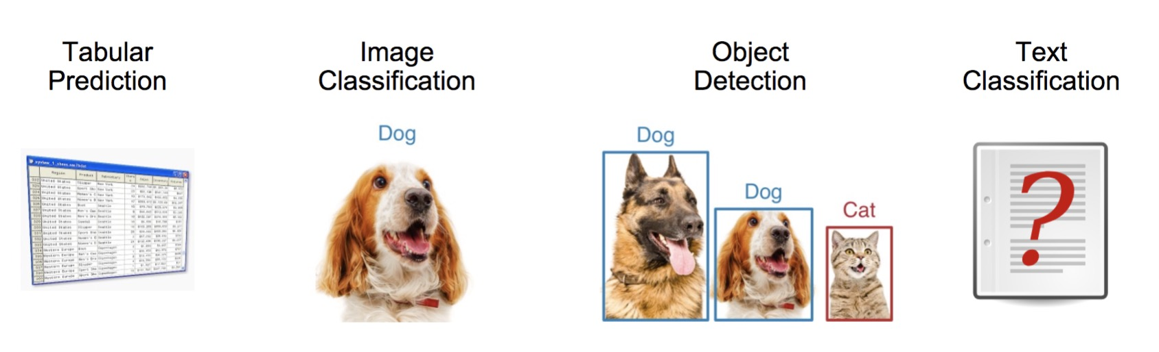
Sub-Modules for text and image tasks

Slide 91
Field | Machine Learning Task | Description
Computer Vision | Semantic Segmentation | Identify different scenes in images.
 | Image Classification | Provide categorical label for images.
 | Object Detection | Identifying object(s) in images.
Natural Language Processing | Sentiment Analysis | Classify text sentiment (e.g. positive, negative).
 | Text Classification | Assign document(s) to categories.
 | Question Answering | Automatically answer questions in natural language.
 | Machine Translation | Translate between languages.
RS | Recommender System | Predict ratings or preferences.

Slide 92
Module 3:
Demo & Hands-on Work

Slide 93
Time for Demo & Hands-On work!
Let’s apply what we’ve learnt to predict book prices for a real dataset.
Go to Docebo and follow the Hands-On Lab instructions to work on your code and make a submission to Leaderboard.

Slide 94
Module 4:
Solution Walkthrough & Discussion

Slide 95
Advanced Features

Slide 96
Optional Settings
from autogluon.tabular import TabularPredictor
predictor = TabularPredictor(label="label").fit("train.csv",
time_limit=2*60, # train various models for approx. 2 minutes
num_bag_folds=5, # number for k-fold cross-validation
num_bag_sets=1, # how many times k-fold cross-vals repeated
num_stack_levels=1, # increase to stack more layers
hyperparameters={"NN": {"num_epochs": XXX}, # hyperparam for NN
"GBM": {"num_boost_round": XXX}}) # hyperparam for GBM
predictions = predictor.predict("test.csv")
In practice: Replace the hyper parameter dummy values with actual numbers.
See the documentation here

Slide 97
Distillation
After Distillation
Original
AutoGluon’s ensemble can teach a simple model (student model) to perform better → gain inference speed with only small loss of model accuracy relative to teacher model.
Student model has low latency, low memory usage, high portability, and can still outperform much heavier ensembles created by other AutoML frameworks.
https://arxiv.org/pdf/2006.14284.pdf

Slide 98
Running Distillation in AutoGluon
To make these faster models, it again takes only one additional line of code:
student_models = predictor.distill(time_limit=XXX)
In practice: Replace the time limit dummy value with time in [s].
See the documentation here. Additional methods to speed up inference here.
Notes:
The time limit here is number of seconds
Distill AutoGluon’s most accurate ensemble-predictor into single models which are simpler/faster and require less memory/compute. Distillation can produce a model that is more accurate than the same model fit directly on the original training data. After calling distill(), there will be more models available in this Predictor, which can be evaluated using predictor.leaderboard(test_data) and deployed with: predictor.predict(test_data, model=MODEL_NAME). This will raise an exception if cache_data=False was previously set in fit().

Slide 99
Deployment
Deployment of models allows us to use them in production and connect to other systems within the company.
How to deploy AutoGluon models?
Create a Docker image in Sagemaker
Create your model
Deploy to an endpoint

Slide 100
Further Reading & Resources
Internal Wiki: https://w.amazon.com/bin/view/AutoGluon
GitHub: https://github.com/awslabs/autogluon
Documentation: https://auto.gluon.ai/stable/index.html
Slack Channel: #autogluon-interest
Subscribe to autogluon-interest@amazon.com

Slide 101
Module 5:
Identifying ML Opportunities

Slide 102
Using ML in practice
Not all problems are suitable for machine learning. How do you know if ML is right for your problem?
Let’s define some questions that guide us through the ML Lifecycle: Machine Learning Decision Questions.

Slide 103
Machine Learning Lifecycle
Answer
New Data/Re-training
Deployment
Business Problem
Yes
Data Processing
Data Collection
Data Exploration
Data Cleaning
…
Model
Training
Tuning
Testing
Evaluation
ML Problem Formulation
No
Notes:
With access to DATA, COMPUTE and ALGORITHMS,
How to do ML? what are the steps to follow?
Putting it all together here as ML Lifecycle, a preview of how much work is ahead…
As mentioned, all starts identifying a Business Problem and formulate the ML Problem
This is a step not to be taken lightly – will impact most of the downstream task
Ask pointed questions:
What are the business outcomes you are trying to achieve?
What does success look like for you?
What business metric to define?
Once settled on the ML Problem, the next step is also time consuming: Data
Know your problem/know your data! (again, and again, the domain expertise of the DS diagram!)
Get all relevant data in one place, cleaned and processed, in a so-called ML-friendly format
That will be all numericals, so you’ll have do to some data processing on those non-numerical features
Maybe also weed out some non-relevant features, or add some relevant ones in, etc
With your ML-friendly data and the right choice of ML algorithm, then
train-tune-validate an ML model
that can be deployed and used in production to produce the desired outcomes, if meets the business goals,
or can be tweaked further until meets the bar, otherwise.

Slide 104

MLDQ Handbook
We summarized some of the most important questions in a handbook:
Machine-Learning-Decision-Questions-Handbook.pdf

Slide 105
Machine Learning Decision Questions

Slide 106
Business problem
Problem formulation
Data processing
Model training
Evaluation
Deployment
When to use ML:
Requires complex logic
Scalability is a challenge
Requires adapting to new data
Needs to be responsive & automated
Notes:
When you encounter a problem, it is important to start by evaluating if it is or is not a good fit to be solved with machine learning. To aid in this, let’s examine 4 points which are indicative of being a good fit for using machine learning, and then on the next slide we’ll talk through some points which are not a good fit. A problem you encounter will not need to satisfy all of these, but if it satisfies none of them you should really consider if the problem is best solved with ML.
[CLICK]
First, the problem should require complex logic. If the task can be solved easily with a few hand-coded rules, or simple heuristics work well enough for the business case, don’t take on the additional complexity of machine learning! It will likely not be worth the investment. This point can be subtle, as there are many problems which may be complex, like some supply chain optimization problems, which are already optimally solved by existing efficient and scalable algorithms.
[CLICK]
Second, if scalability is a challenge, that is a strong indicator that ML could help. If there is a task that you normally require a human to do, but you want to do it millions of billions of times, training an ML model to perform that task, and then deploying it at scale is a good solution.
[CLICK]
Third, if we need to make predictions for unseen data, we need ML.
[CLICK]
Finally, if you need the system to be more responsive than a human could achieve. If there is a task that would normally require human reasoning that you need done in less than a tenth of a second, ML is often an excellent solution. Examples include things like face detection for autofocus on cameras, or automated content moderation on a social media platform.

Slide 107
Business problem
Problem formulation
Data processing
Model training
Evaluation
Deployment
When NOT to use ML:
Can be solved with traditional algorithms
Requires 100% accuracy
Requires full interpretability
Notes:
Conversely, let’s now talk about some factors of problems that mean that ML cannot be successfully applied. Having one of these does not mean that ML cannot be used, but it might inform choices that need to be made during the development process, or lead to an extended timeline for development.
[CLICK]
First is just a reiteration of what we’ve said before: if the problem can be solved with existing efficient algorithms, ML will provide no benefit.
[CLICK]
If the problem requires 100% accuracy, you should not use ML. Machine learning is inherently about estimation, and can provide no guarantees of perfect accuracy.
[CLICK]
Finally, if interpretability is required then that limits the types of ML that can be applied to a problem. Unlike a human, we cannot ask the algorithm how it made its decision. The majority of the most powerful ML models are black-box models, producing results with no indication of why.

Slide 108
Let’s apply MLDQs to Amazon Use Cases
Notes:
Here we’re going to give you the chance to share your business problem you wrote down at the beginning of class so you can get feedback on how to turn it into an ML problem.

Slide 109
Use Case 1: Backfilling Missing Attributes
We will now use a subset of questions from the MLDQ handbook to discuss ML problems that teams at Amazon have faced.
Use Case 1: Backfilling Missing Attributes in the Amazon Catalog
For many products in the Amazon Catalog, attributes (e.g. color, size) are missing or incorrect. Amazon loses customer trust when product results don’t match what a customer is looking for, and loses sales when ASINs (product attributes) have been labeled incorrectly or are undiscoverable.
We want to build ML models that can predict attributes from product images; for example color. We can use those models to predict and backfill the color attribute in the catalog.

Slide 110

Molino
https://w.amazon.com/bin/view/InTech/Tamale/Projects/Molino/
Notes:
Molino deploys several types of ML models to predict different attributes (color, style).

Slide 111
MLDQs for discussion
What makes this problem suitable for Machine Learning?
What business goal can be achieved by building a ML solution to tackle this problem?
What kind of ML model (regression/classification/clustering?) can solve this problem?
What data might be necessary to address this problem? Is the data already available & relevant?
What metric should be used to evaluate the model?

Slide 112
MLDQs for discussion
What makes this problem suitable for Machine Learning?
Manual extraction and labelling of colors is not scalable. Simple rules based on pixel inspection will not solve many real cases (presence of a human model, pictures with large white background areas, etc.)

Slide 113
MLDQs for discussion
What makes this problem suitable for Machine Learning?
Manual extraction and labelling of colors is not scalable. Simple rules based on pixel inspection will not solve many real cases (presence of a human model, pictures with large white background areas, etc.)
What business goal can be achieved by building a ML solution to tackle this problem?
Customer trust: Complete and accurate product information across all marketplaces will provide a better shopping experience to Amazon customers and will lead to higher customer trust, increasing sales.

Slide 114
MLDQs for discussion
What makes this problem suitable for Machine Learning?
Manual extraction and labelling of colors is not scalable. Simple rules based on pixel inspection will not solve many real cases (presence of a human model, pictures with large white background areas, etc.)
What business goal can be achieved by building a ML solution to tackle this problem?
Customer trust: Complete and accurate product information across all marketplaces will provide a better shopping experience to Amazon customers and will lead to higher customer trust, increasing sales.
What kind of ML model (regression/classification/clustering?) can solve this problem?
Multi-class classification (many different colors) can be used.

Slide 115
MLDQs for discussion
What data might be necessary to address this problem? Is the data already available & relevant?
To solve this, we need a dataset with images with correspondent color labels. Potentially, some sellers may already provide color values for their products but those may be not accurate and require additional verification.

Slide 116
MLDQs for discussion
What data might be necessary to address this problem? Is the data already available & relevant?
To solve this, we need a dataset with images with correspondent color labels. Potentially, some sellers may already provide color values for their products but those may be not accurate and require additional verification.
What metric should be used to evaluate the model?
Various classification metrics may be used, including accuracy, precision and recall. However, to keep the quality bar high we define thresholds for every class so only very confident predictions are published to the catalogue (i.e. with precision > 90%).

Slide 117
Use Case 2: Sentiment Analysis
We will now use a subset of questions from the MLDQ handbook to discuss ML problems that teams at Amazon have faced.
Use Case 2: Sentiment Classification of Customers’ Feedback in Heartbeat
Amazon customers’ feedback data (customer service contacts, product reviews, return comments) encapsulates valuable information about users. Sentiment analysis, the NLP task that consists of extracting subjective opinions and emotions from textual cues, provides a unique window into customers’ experience. Understanding text sentiment allows Amazon to improve their products to better meet customers’ needs.
We want to build ML predictive models that can generate sentiment analysis scores for Heartbeat (the Voice of the Customer) text data.

Slide 118

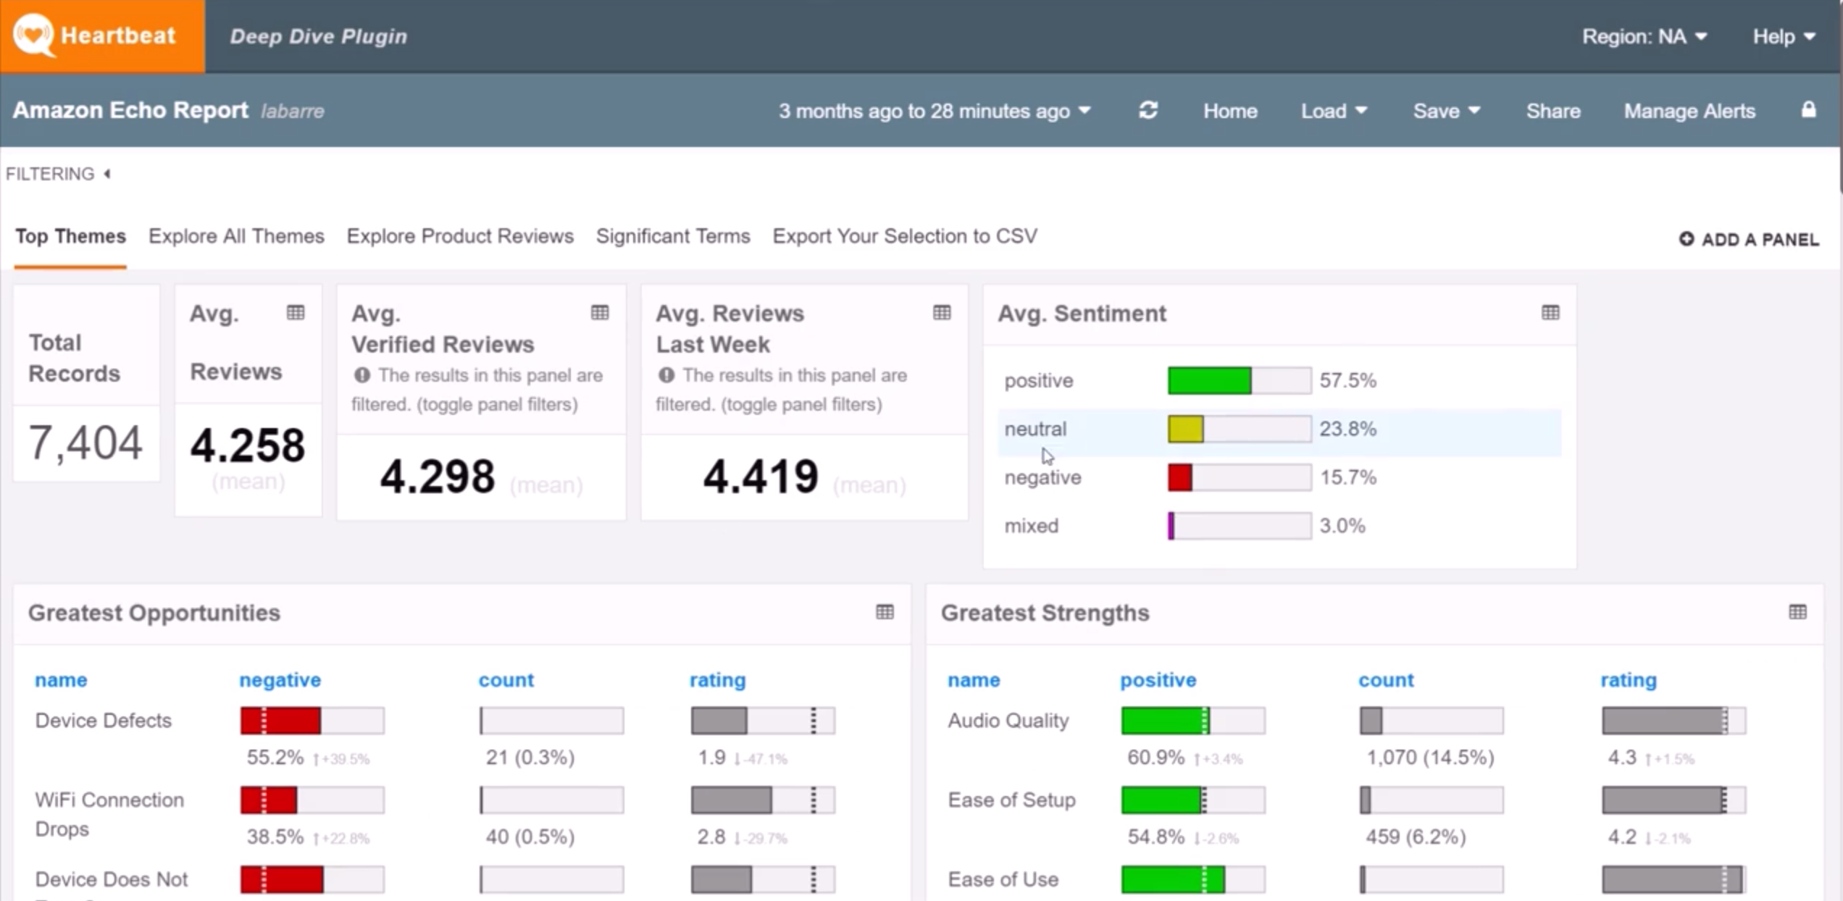
Heartbeat
https://w.amazon.com/index.php/CSTech/Heartbeat
Notes:
Heartbeat uses a sentiment scorer to classify customer feedback as positive/netural/negative/mixed.
More info: https://drive.corp.amazon.com/documents/szarvasg@/tech_reports/sentiment.pdf
More info: https://w.amazon.com/bin/view/CSTech/Heartbeat/NLP/AspectBasedSentiment/
Labels are quite stable, all d2cs and beauty sets were triple annotated by pre-selected MTurk workers.
See here for Sigmund – a Sentiment Analysis Scoring Improvement in Heartbeat: https://w.amazon.com/bin/view/WWDE_ML/home/sentiment_scoring_in_heartbeat/

Slide 119
MLDQs for discussion
What makes this problem suitable for Machine Learning?
What business goal can be achieved by building a ML solution to tackle this problem?
What kind of ML model (regression/classification/clustering?) can solve this problem?
What data might be necessary to address this problem? Is the data already available & relevant?
What metric should be used to evaluate the model?

Slide 120
MLDQs for discussion
What makes this problem suitable for Machine Learning?
Manual extraction of text sentiment at scale is intractable. Simple rules based on presence of positive or negative words in a sentence will not solve many real cases (nuanced language, mixed sentiments, etc)

Slide 121
MLDQs for discussion
What makes this problem suitable for Machine Learning?
Manual extraction of text sentiment at scale is intractable. Simple rules based on presence of positive or negative words in a sentence will not solve many real cases (nuanced language, mixed sentiments, etc)
What business goal can be achieved by building a ML solution to tackle this problem?
Customer understanding: Knowing what users think and how they feel about products adds context to the raw text and enables prioritization. It also helps surface problems and customer dissatisfaction early on.

Slide 122
MLDQs for discussion
What makes this problem suitable for Machine Learning?
Manual extraction of text sentiment at scale is intractable. Simple rules based on presence of positive or negative words in a sentence will not solve many real cases (nuanced language, mixed sentiments, etc)
What business goal can be achieved by building a ML solution to tackle this problem?
Customer understanding: Knowing what users think and how they feel about products adds context to the raw text and enables prioritization. It also helps surface problems and customer dissatisfaction early on.
What kind of ML model (regression/classification/clustering?) can solve this problem?
Either binary classification (positive/negative) or multi-class classification (scale of sentiments from angry to neutral to happy) can be used. Heartbeat uses 4 classes: positive/negative/neutral/mixed.

Slide 123
MLDQs for discussion
What data might be necessary to address this problem? Is the data already available & relevant?
To solve this, we need a dataset with text (customer contacts, product reviews, return messages) with correspondent sentiment labels. Text data can be extracted from Heartbeat. Human annotation of it is required, which might be costly.

Slide 124
MLDQs for discussion
What data might be necessary to address this problem? Is the data already available & relevant?
To solve this, we need a dataset with text (customer contacts, product reviews, return messages) with correspondent sentiment labels. Text data can be extracted from Heartbeat. Human annotation of it is required, which might be costly.
What metric should be used to evaluate the model?
Typically classification accuracy will be used. Both micro- and macro-averages over the multiple sentiment classes can be computed to identify the performance of the classifier towards the different labels.

Slide 125
Let’s apply this to YOUR Problem ☺
Notes:
Here we’re going to give you the chance to share your business problem you wrote down at the beginning of class so you can get feedback on how to turn it into an ML problem.

Slide 126
Applying MLDQs to YOUR problem
We will now use the same subset of questions from the MLDQ handbook as in the last activity to discuss the ML problems we asked you to write down at the beginning of the class in small breakout groups.
If you don’t have a suitable ML problem, we will share an example for discussion.

Slide 127
MLDQs for discussion
What makes this problem it suitable for Machine Learning?
What business goal can be achieved by building a ML solution to tackle this problem?
What kind of ML model (regression/classification/clustering?) can solve this problem?
What data might be necessary to address this problem? Is the data already available & relevant?
What metric should be used to evaluate the model?

Slide 128
Stay Connected

Slide 129
Explore the world of MLU
Next Steps: | Links:
Ready to register for your next MLU course? Enroll for another today | MLU Registration
Check out our new classes, events, and program updates. See our wiki for more information. | MLU Wiki
Have a question about MLU? Explore our FAQs as a first step. | MLU FAQ
Stay connected with fellow students and MLU alumni! | Slack channel: #mlu-machine-learning-university
Subscribe to our newsletter and interest alias for monthly program updates and exciting launches! | MLU Newsletter MLU Interest Alias
Engage with the Amazon ML Research Community and join us for virtual tech talks | MLU Tech Talks
Solve real Amazon business problems and have some fun using your new ML skills! | ML Challenges

Slide 130
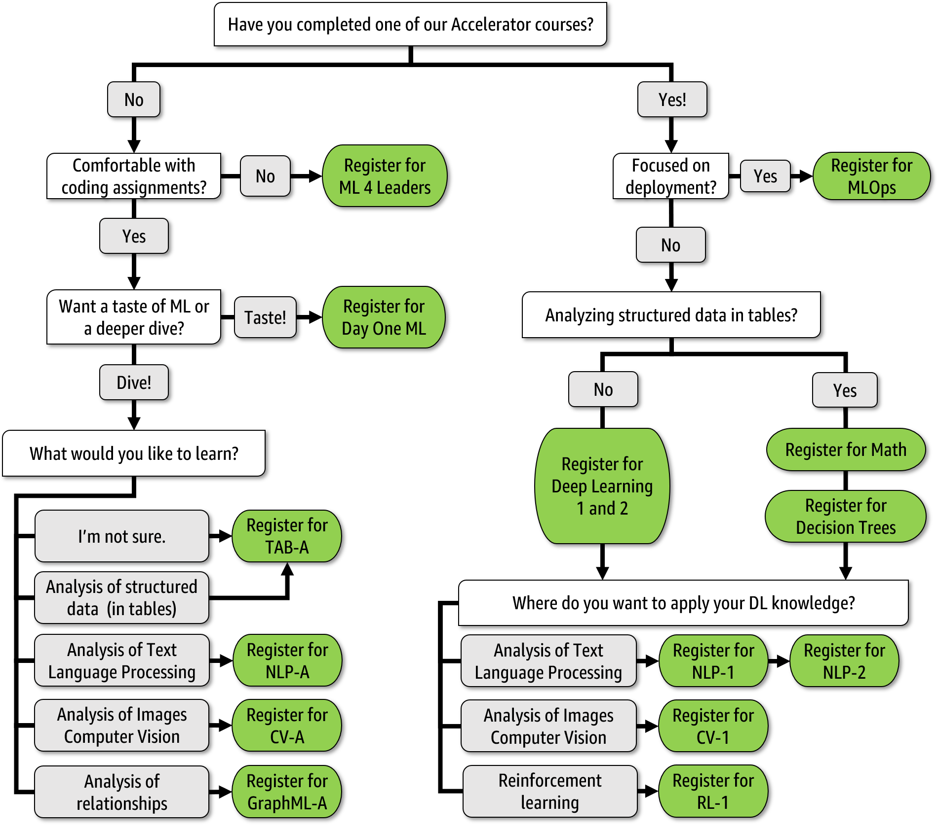
You are here

Slide 131
Instructor Alias: TK
Start Date: TK

